Slide 1
SQLite Internals
오기환
(wurikiji@gmail.com)
SKKU VLDB Lab. (27334)

Slide 2
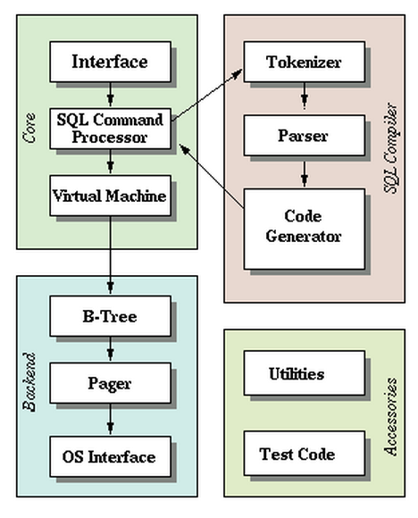
SQLite Internals - 1/3

Slide 3
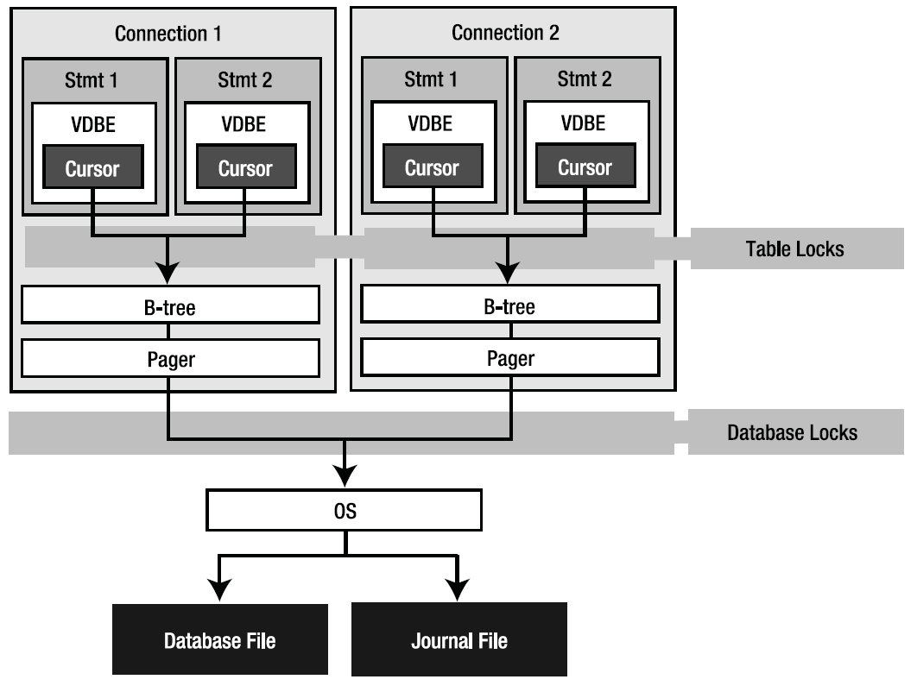
SQLite Internals - 2/3

Slide 4
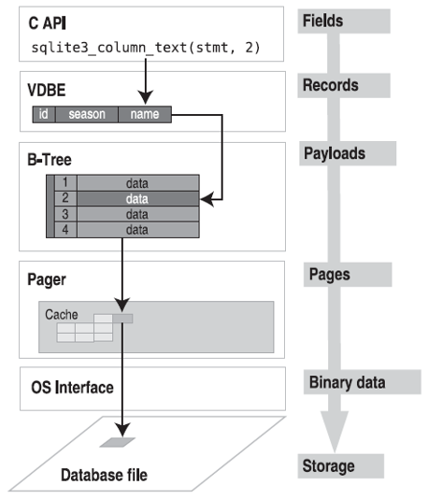
SQLite Internals - 3/3

Slide 5
SQLite B+tree module

Slide 6
B+Tree in SQLite
An SQLite database is maintained on disk using a B-tree implementation
A separate B-tree is used for each table and index in the database
All B-trees are stored in the same disk file
Source codes are separated as 3 files
btreeInt.h, btree.h, btree.c

Slide 7
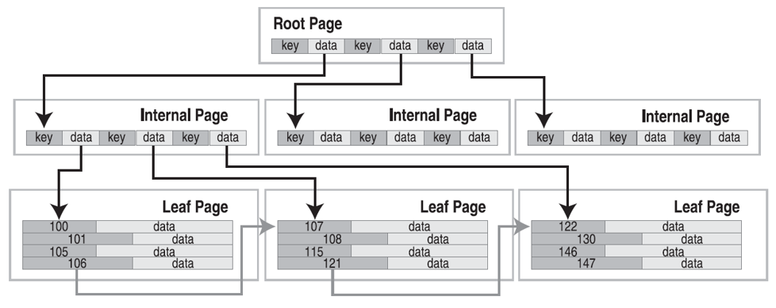
B+tree Internals in SQLite - 1/2

Slide 8
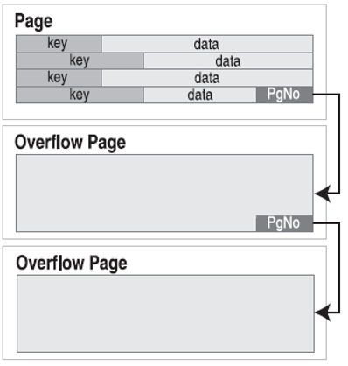
B+tree Internals in SQLite - 2/2

Slide 9
Page structure
File Header
First page only has 100 bytes
Page Header
8 bytes for leaves
12 bytes for interiors
Cell
Real data
File Header
Page Header
Cell Pointers
Free Space
Cell Contents

Slide 10
Normal Page header
Normal page is btree node page
Offset | Size | Description
0 | 1 | 1: intkey, 2: zerodata, 4: leafdata, 8: leaf
1 | 2 | byte offset to the first freeblock
3 | 2 | number of cells on this page
5 | 2 | first byte of the cell content area
7 | 1 | number of fragmented free bytes
8 | 4 | right child node

Slide 11
Free Page header
Free page - unallocated page
Offset | Size | Description
0 | 4 | Page number of next free page
4 | 4 | Number of leaf pointers on this page
8 | * | Zero or more pages numbers of leaves
PGNO
# of pointers
p2
p3
.....
pN

Slide 12
Overflow Page header
Overflow page stores the overflowed data
Offset | Size | Description
0 | 4 | Page number of next overflow page
4 | * | Data
Data
Next PGNO
Overflow Data
Next PGNO

Slide 13
SQLite Pager module

Slide 14
Page Cache in SQLite - 1/2
The B+tree module requests information from the disk in fixed-size chunks
The page cache is responsible for reading, writing, and caching these chunks
The page cache also provides the rollback and atomic commit abstraction and takes care of locking of the database file

Slide 15
Page Cache in SQLite - 2/2
The B+tree module requests particular pages from the page cache and notifies the page cache when it wants to modify pages
We call the module that manages page cache “pager”
Source codes are separated as 2 files
pager.h, pager.c

Slide 17
Design of the Pager
A page of the database file is said to be “overwriteable” if
The original content has been written into the rollback journal and synced
The page was a freelist leaf page
The page number is greater than the largest page that existed at the start of the transaction

Slide 18
Design of the Pager
Writes to the database file are an integer multiple of the page size in length and are aligned on a page boundary
Pager implements atomic commit and file locking

Slide 19
File Header

Slide 20
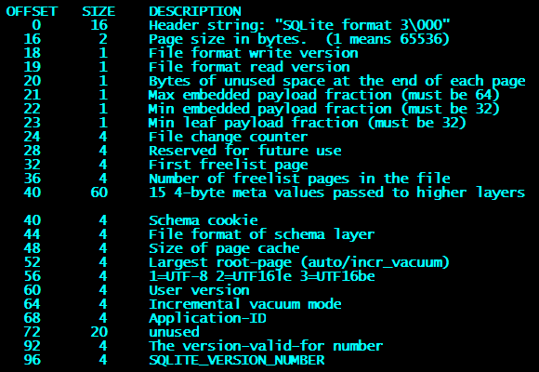
DB File Header
page size divided by 256

Slide 21
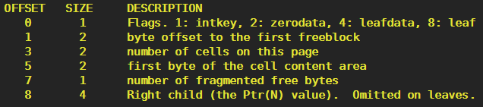
DB Page Header
For flags
0x02: Index b+tree internal node
0x0A: Index b+tree leaf node
0x05: Table B-tree internal node
0x0D: Table B-tree leaf node

Slide 22

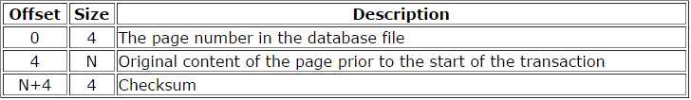
RBJ File Header
Journal Header
Journal record format

Slide 23
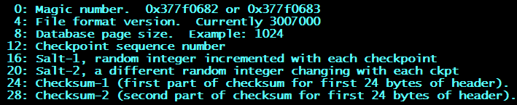
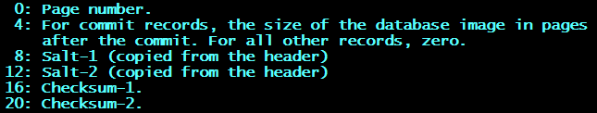
WAL File Header
WAL File Header
WAL Frame Header

Slide 24
main Codes

Slide 25
btreeInt.h
struct MemPage
In-memory page management structure
struct Btree
A database connection handler
struct BtShared
An instance represents a single database file

Slide 26
btree - Access and Transaction
sqlite3BtreeOpen
sqlite3BtreeClose
sqlite3BtreeBeginTrans
sqlite3BtreeBeginStmt
sqlite3BtreeCommit
sqlite3BtreeRollback

Slide 27
btree - Table
sqlite3BtreeCreateTable
sqlite3BtreeDroptable
sqlite3BtreeClearTable

Slide 28
btree - Record
sqlite3BtreeDelete
sqlite3BtreeInsert
sqlite3BtreeKey
sqlite3BtreeData
sqlite3BtreePutData

Slide 29
Pager - Page Cache Management
struct Pager
sqlite3PagerOpen
sqlite3PagerClose
sqlite3SetPageSize
sqlite3PagerSetCachesize
sqlite3SetJournalMode

Slide 30
Pager - Page management
sqlite3PagerAcquire
sqlite3PagerLookup
sqlite3PagerRef/Unref
sqlite3PagerWrite

Slide 31
Pager - Transaction
sqlite3PagerBegin
sqlite3PagerCommitPhaseOne/Two
sqlite3PagerSync
sqlite3PagerRollback

